Slide 1
THE HEART OF AN EFFECTIVE INTERCESSOR
WAILING WOMEN CARIBBEAN TRAINING JULY 26 2022
WORDS FROM THE FATHER’S HEART
VOL 3

Slide 2
WHAT DOES THE BIBLE SAY ABOUR THE HEART

Slide 3
WHAT DOES THE BIBLE SAY ABOUR THE HEART
As water reflects the face, so one’s life reflects the heart(Prov 27:19)
How do we check our heart condition?
An honest heart seeks to please God in all things and offend Him in none.” – A. W. Pinkask
“ It does not matter what work you do and how mean it is , I am interested in the heart with which you do the work”

Slide 4
WHAT DOES THE BIBLE SAY ABOUR THE HEART
“ I judge from the intents and motives of your hearts. Your hearts speak and I hear the voice of the heart.
Keep thy heart with all diligence; for out of it are the issues of life. Prov 4:23
How do we guard our hearts?
Listen in silence because if your heart is full of other things you cannot hear the voice of God.”

Slide 5
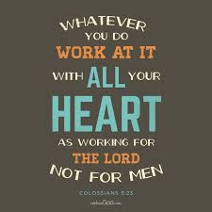
WHAT DOES THE BIBLE SAY ABOUR THE HEART
How do we work from our hearts?
We must alter our lives in order to alter our hearts, for it is impossible to live one way and pray another
Do your best. Work from the heart for your real Master, for God, confident that you’ll get paid in full when you come into your inheritance. Keep in mind always that the ultimate Master you’re serving is Christ.
“Offer unto me willingly a sacrifice that is acceptable. Your sacrifice comes to me with the motive, intent and relationship from the heart

Slide 6
ISSUES AFFECTING THE HEART
“Remove every infiltration, it causes congestion, When the heart is congested and twisted, it affects the FLOW. There is an obstruction, there is no free flow”
Jeremiah 17:9-10 | STATEMENT
The heart is deceitful above all things, and desperately sick; who can understand it | The heart if man is exceedingly prone to undue and sinful anger, being naturally full of pride and selfishness.

Slide 7
ISSUES AFFECTING THE HEART
Mark 7:21-23 | STATEMENT
For from within, out of the heart of man, come evil thoughts, sexual immorality, theft, murder, adultery, coveting, wickedness, deceit, sensuality, envy, slander, pride, foolishness. All these evil things come from within, and they defile a person.” | Our depravity, our sin, places us at enmity against God. Because of this, we are guilty before a Just Judge.
“The man you are made of is in your heart; A wicked man is known by the heart he has

Slide 8
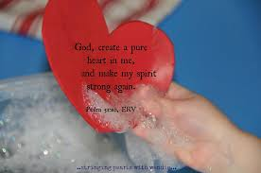
WHAT ARE WE CALLED TO DO?
“The consent of the heart carries the action.
Remove the blocks of the heart

Slide 9
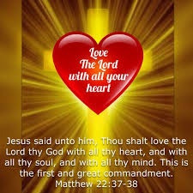
WHAT ARE WE CALLED TO DO?
“If I carry out this operation, will you make a promise that you will not allow sedimentation in your heart again? That you will allow a free passage and will not choke My Spirit?

Slide 10
WHAT ARE WE CALLED TO DO?
“The antidote for the heart is.. IT IS WRITTEN.
Major battles are fought in the heart.

Slide 11
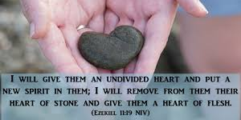
WHAT OUR FATHER WILL DO WHEN WE ALLOW HIM ACCESS TO OUR HEARTS

